Slide 1
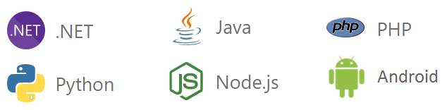
Microsoft Azure
Azure is a Microsoft’s cloud computing platform
Microsoft Azure is a cloud computing platform and an online portal that allows you to access and manage cloud services and resources.
It provides a wide range of cloud services like computing, storage, databases, AI, networking, DevOps, and more.
To get access to these resources and services, all you need to have is an active internet connection and subscription to connect to the Azure portal.
Users can build, test, deploy, and manage applications via Microsoft-managed data centers.
Microsoft Azure helps you to build and manage enterprise level web, mobile, IoT apps faster using your existing skills and technologies you know.

Slide 2
Benefits of Microsoft Azure
Benefit | Description
✅ Scalability | Easily scale up/down based on demand
💰 Cost-effective | Pay-as-you-go pricing, no hardware costs
🔒 Secure | Enterprise-grade security, compliance
🌍 Global Reach | Data centers in over 60+ regions
⚙️ Hybrid Ready | Works with on-premise systems (Hybrid cloud)
🚀 Innovation | AI, ML, IoT, Analytics, DevOps tools

Slide 3
Advantages of Microsoft Azure
🌟 Advantage | 📝 Description
Scalability | Automatically scale up or down based on demand—ideal for apps with variable loads.
Cost-Effective | Pay-as-you-go pricing model; no need to invest in expensive hardware.
High Availability | 99.95% uptime SLA with global data centers ensures reliability.
Security | Enterprise-grade security with multi-layered protection and compliance standards.
Global Reach | Azure is available in 60+ regions across the globe.
Flexibility | Supports multiple operating systems, languages, tools, and frameworks.

Slide 4
Advantages of Microsoft Azure
🌟 Advantage | 📝 Description
Disaster Recovery | Built-in backup and site recovery options for business continuity.
Hybrid Capability | Seamless integration with on-premise environments.
AI and Analytics | Advanced services like Azure Machine Learning and Power BI integration.
Developer-Friendly | Integration with Visual Studio, GitHub, Azure DevOps for fast development.
Compliance Ready | Meets global compliance standards like GDPR, ISO, HIPAA, etc.
Automation | Automate deployment and management using Azure CLI, PowerShell, and ARM templates.

Slide 5
Core Azure Services Categories
🛠️ Category | 🔧 Service Name | 📝 Description
Compute | Azure Virtual Machines (VMs) | Scalable, on-demand computing resources (IaaS).
 | Azure App Service | Host web apps, REST APIs, and mobile backends (PaaS).
 | Azure Functions | Event-driven serverless computing.
 | Azure Kubernetes Service (AKS) | Manages containerized apps using Kubernetes.
Storage | Blob Storage | Object storage for unstructured data (images, videos, docs).
 | File Storage | Fully managed file shares (SMB protocol).
 | Queue Storage | Messaging store for decoupling app components.
 | Disk Storage | High-performance disks for VMs and apps.

Slide 6
Core Azure Services Categories
🛠️ Category | 🔧 Service Name | 📝 Description
Databases | Azure SQL Database | Fully managed relational database (PaaS).
 | Azure Cosmos DB | Globally distributed NoSQL database.
 | Azure Database for MySQL/PostgreSQL | Managed open-source database services.
Networking | Virtual Network (VNet) | Securely connect Azure resources.
 | Azure Load Balancer | Distributes traffic across resources.
 | Azure DNS | Host and manage your domain’s DNS records.
 | Application Gateway | Load balancer with web application firewall (WAF).

Slide 7
Core Azure Services Categories
🛠️ Category | 🔧 Service Name | 📝 Description
Identity & Access | Azure Active Directory (AAD) | Identity management and access control.
 | Multi-Factor Authentication (MFA) | Adds a second layer of security for user sign-ins.
 | Azure AD B2C | Customer identity and access management.
AI & ML | Azure Machine Learning | Build, train, and deploy ML models.
 | Cognitive Services | Pre-built AI services like speech, vision, and language.
 | Bot Service | Develop intelligent, serverless bots.

Slide 8
Core Azure Services Categories
🛠️ Category | 🔧 Service Name | 📝 Description
DevOps | Azure DevOps Services | CI/CD, project tracking, source control, testing.
 | GitHub Actions | Automate workflows directly from GitHub.
Security | Azure Security Center | Unified security management and threat protection.
 | Azure Key Vault | Securely store keys, secrets, and certificates.
 | Microsoft Defender for Cloud | Advanced threat protection for workloads.
Monitoring | Azure Monitor | Full-stack monitoring and analytics.
 | Application Insights | Performance monitoring for apps.
 | Azure Log Analytics | Query and analyze logs across resources.

Slide 9
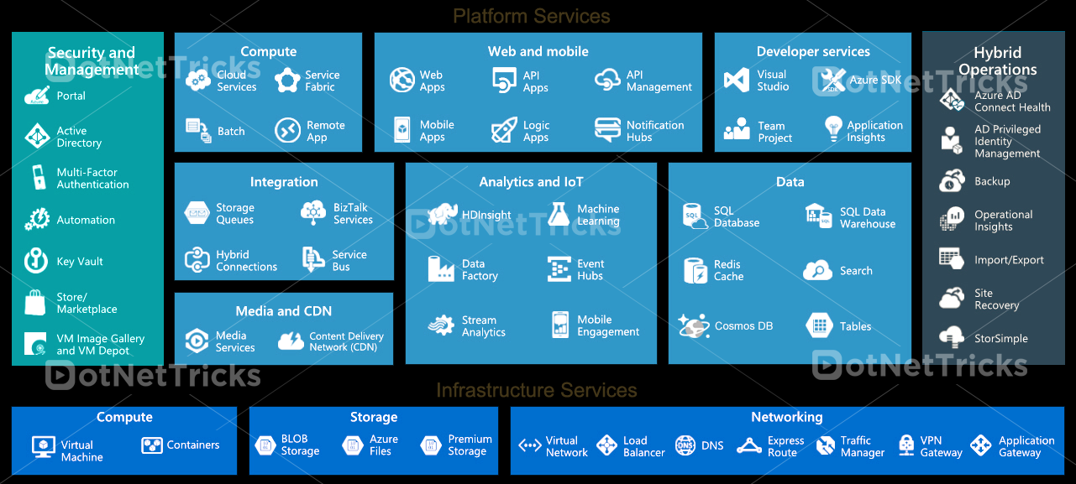
Azure Services
Microsoft Azure offers so many services through its cloud computing platform.

Slide 10
Azure Core Concepts/Terminology
🔑 Concept | 📝 Description
Azure Subscription | A logical container that holds Azure resources and is tied to billing information.
Resource | Any manageable item in Azure (e.g., VM, SQL DB, Storage Account).
Resource Group | A container that holds related resources for an Azure solution.
Region | A set of data centers located within a specific geographic location.
Availability Zone | Physically separate zones within a region to ensure high availability.
Azure Portal | A web-based interface for managing and monitoring Azure services.
Azure CLI | Command-line tool to manage Azure resources using scripts and commands.

Slide 11
Azure Core Concepts/Terminology
🔑 Concept | 📝 Description
ARM (Azure Resource Manager) | The deployment and management service for Azure. Allows infrastructure as code.
Azure Marketplace | Online store for certified, pre-configured applications and services.
Tags | Key-value pairs used to organize and manage Azure resources (e.g., by department).
Management Groups | Used to manage access, policy, and compliance across multiple Azure subscriptions.

Slide 12
Azure Service Models (Cloud Service Models)
Model | Description | Examples
IaaS(Infrastructure as a Service) | Provides VMs, networking, storage | Azure Virtual Machines
PaaS(Platform as a Service) | Platform for developing apps without managing infrastructure | Azure App Services, Azure Functions
SaaS(Software as a Service) | Ready-to-use applications over the internet | Microsoft 365, Outlook, OneDrive

Slide 13
Common Azure Use Cases
Scenario | Azure Solution
Host Websites | Azure App Service
Store Large Files | Azure Blob Storage
Virtual Servers | Azure Virtual Machines
IoT Applications | Azure IoT Hub
Machine Learning | Azure ML Studio
Backup & DR | Azure Site Recovery

Slide 14
Microsoft Azure Certifications
AZ-900 – Azure Fundamentals (Ideal for beginners)
AZ-104 – Azure Administrator Associate
AZ-204 – Azure Developer Associate
AZ-500 – Azure Security Engineer Associate

